Slide 1
Learning a Distance for the Clustering of Patients with Amyotrophic Lateral Sclerosis
Katherine Le

Slide 2
Overview
ALS research is limited
  Small samples
  Longitudinal data
  Current patient clustering lacks clinical meaning for preventative/personalized care
This study improves clustering by:
  Pairing clustering algorithms with multiple distance measures
  Combining several descriptive variables from patient progression data
Evaluation
  Method outperformed existing approaches in survival analysis when evaluated on a dataset sof 353 ASL patients.

Slide 3
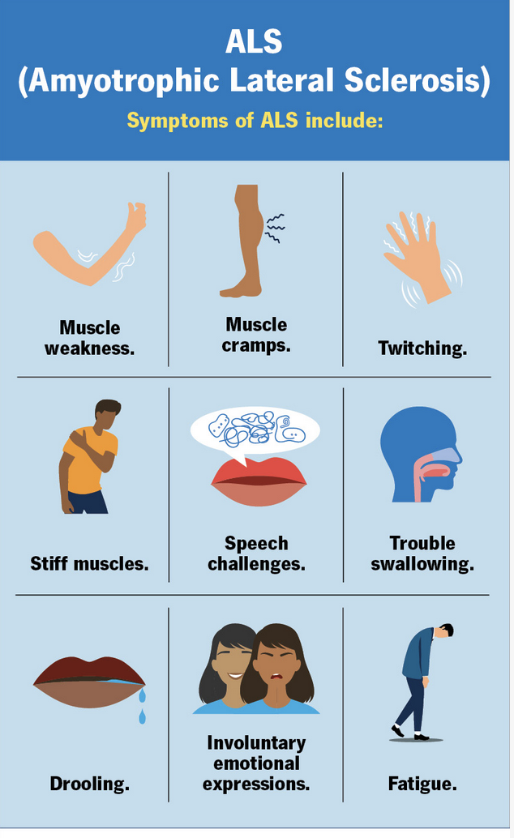
What is ALS?
Fatal neurodegenerative disease of the central nervous system
  Affect motor neurons in the brain and spinal cord which controls voluntary muscle movements
  Hard to diagnose in its early stages
  Typical survival of 3-5 years after symptom onset

Slide 4
Dataset Constraints
Data sparsity and limited variety
  Costly and invasive data collection procedures
  Strict regulations
Data is fragmented and incomplete
  Limits the generalization ability of machine learning models → difficult to identity distinct patient clusters

Slide 5
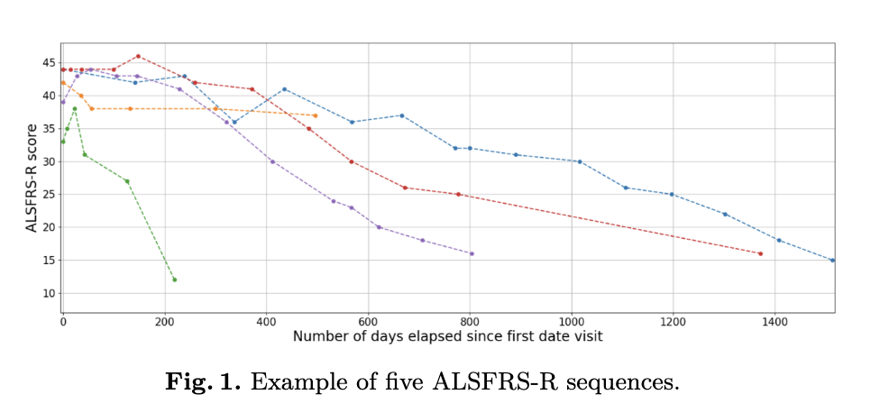
ALSFRS-R (ALS Functional Rating Scale-Revised)
ALSFRS-R is the standard reference for measuring ALS progression
  Total score from 0 (total physical function loss) to 48 (no functional impairment)
  This is the longitudinal clinical data that is used to identify clusters

Slide 6
Current Research on ALS patient clustering

Slide 7
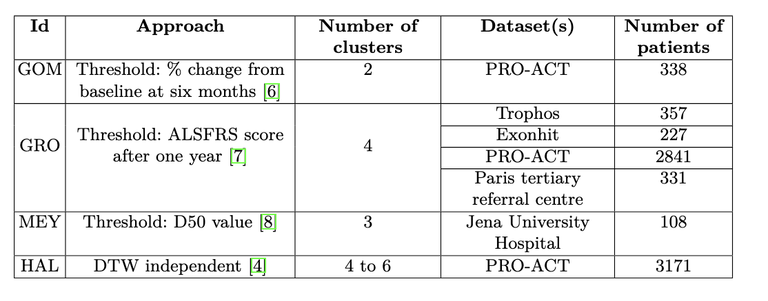
Clustering based on progression thresholds
Observe ALSFRS-R score at a specific point in time
  Use thresholds to determine clusters
Limitations with this approach:
  Small changes near the threshold can move a data point into a different group when the difference is clinically negligible in reality
  This reduces a sequence into a single value making it difficult to identify diverse clusters
  A single criterion cannot fully characterize ALS

Slide 8

Available Datasets
PRO-ACT
  Dataset of 10,000 ALS patients with a variety of clinical and biological parameters
Limitations of PRO-ACT:
  Patients are from different clinical trials leading to inconsistent follow-up frequencies and unit conventions
  Data only starts from the diagnosis and onwards, no data about first few follow-up visits
  Cannot contact the clinicians who worked with the patients so there is no contextual understanding of the data
Dataset used in study
  From a hospital where physicians can be contacted

Slide 9
Clustering Approach

Slide 10
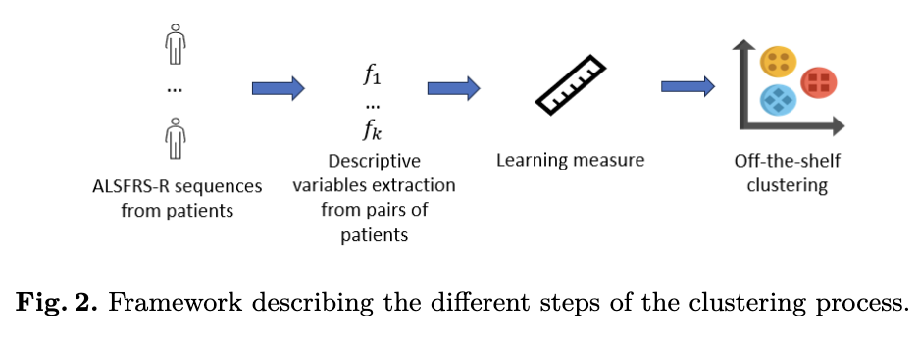
General Framework

Slide 11
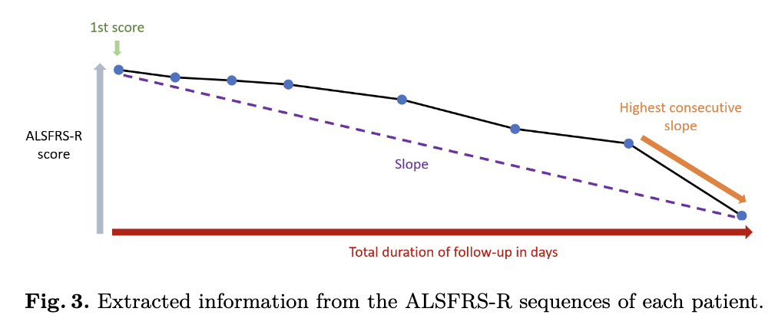
Extracting Descriptive Variables
2 types of key features from ALSRFS-R score
  Sequence based: calculated directly from raw score
    Follow up duration - How long the patient was tracked
    Score at the first visit - The patient’s ALSFRS-R score when the patient’s follow-up started
    Overall slope - The average rate of decline in their score
    Stiffest slope - Largest drop that happened between any 2 consecutive visits

Slide 12
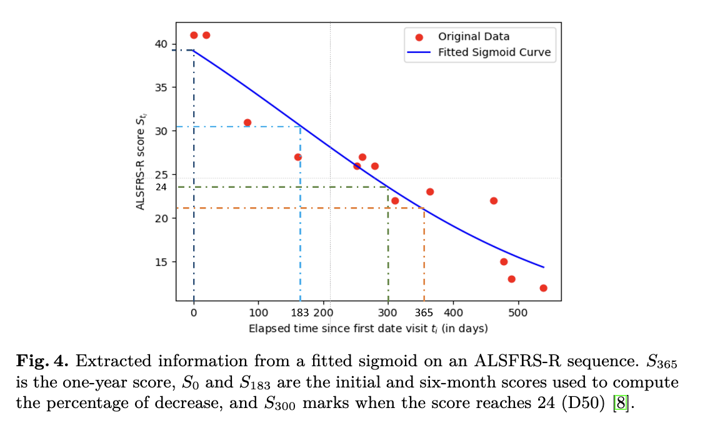
Extracting Descriptive Variables (continued)
  Sigmoid based: Fit a smooth curve (sigmoid function) through each patient’s data to estimate missing points
    This accounts for patients not visiting on the same schedule
    ALSFRS-R score after one year - What model predicts the score will be 365 days after starting
    Percentage decline after 6 months - How much the score dropped after 6 months
    D50 value - The time in days when the predicted score reaches 24 (midpoint)

Slide 13
Comparing Two Patients
For each pair of two patients, the absolute difference is calculated between their feature values
  Describes how different two patients’ disease progressions are
  DURATION_DIFF - Difference in how long they were followed
  FIRST_SCORE_DIFF - Difference in their starting scores
  SLOPE_DIFF - Difference in how quickly they decline overall
  HIGHEST_CONSECUTIVE_SLOPE_DIFF - Difference in their steepest single drop
  ALS_SCORE_M12_DIFF - Difference in their predicted scores after 1 year
  PC_CHANGE_M6_DIFF - Difference in their % decline after 6 months
  D50_DIFF - Difference in when they reach score 24

Slide 14
Proposed Distances
Two ways to measure how far apart two patients are from the set of 7 descriptive features for each patient
  These distance measures will be used for clustering
  Each patient is represented as a vector with 7 elements for the 7 features

Slide 15
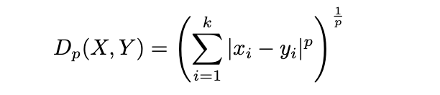
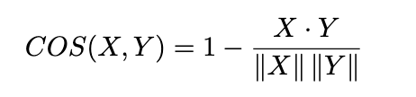
Off-the-shelf Methods
Minkowski Distance
  General formula for measuring distance between two vectors
Cosine Distance
  Measures how similar the directions of two vectors are

Slide 16
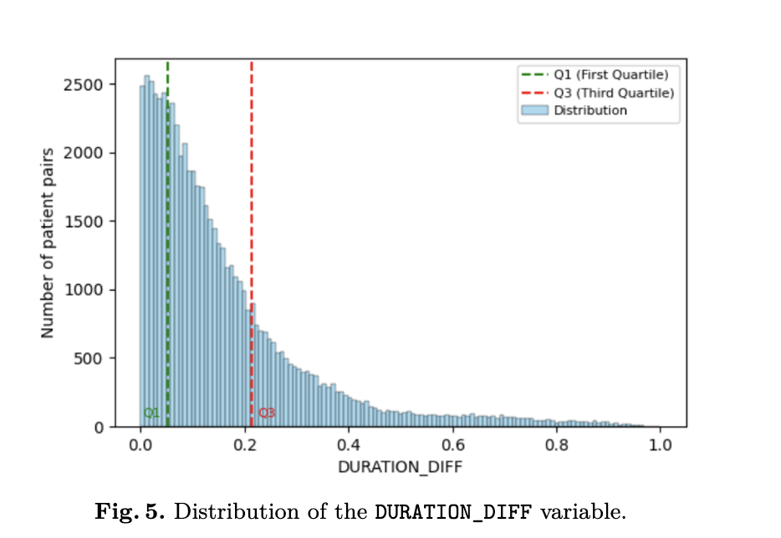
Weakly Supervised Machine Learning Distance
Learns how to weigh different features so that we can see which types of differences matter more when comparing patients
Label pairs of patients - create approximate labels based on physician rules
  Make 7 labeling functions one for each feature and each function looks at the value of a feature and assigns different labels:
    T (Together) if the difference is small
    S (Separated) if the difference is large
    U (Undetermined) if the different is in between

Slide 17
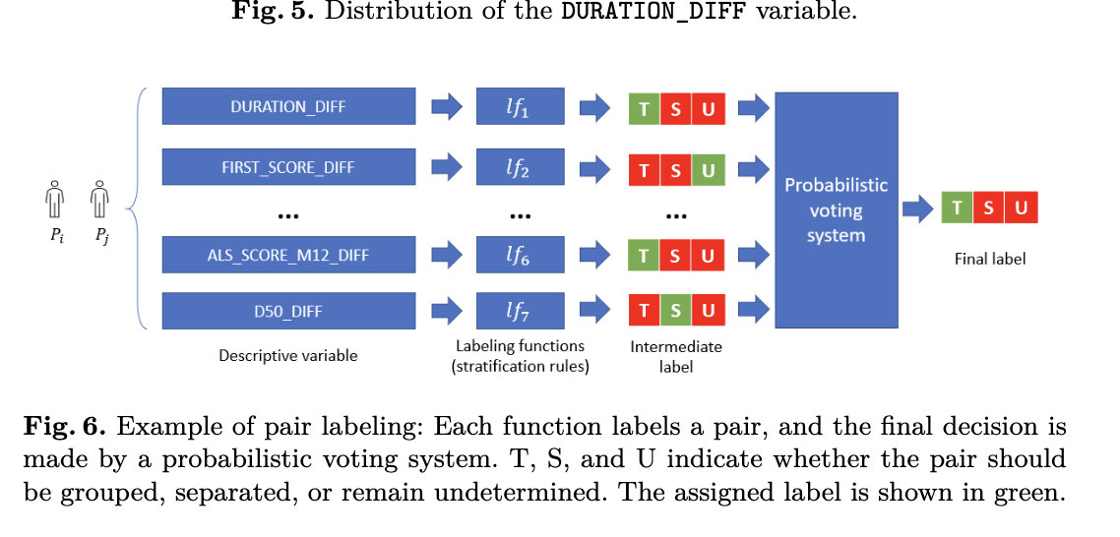
Weakly Supervised Machine Learning Distance (continued)
Combine labels using voting system
  Probabilistic voting system - a model that learns how reliable each labeling function is
  Looks at how each function agrees or disagrees with the others
  Estimates each function’s accuracy and correlation
  Produces a final label for each pair T or S with an associated probability

Slide 18
Weakly Supervised Machine Learning Distance (continued)
Train a classifier to learn feature weights
  After probabilistic labels, train a SVM to learn which features best predict whether 2 patients should be together or separated
  This produces a weight wi for each of the 7 variables
  Pairs with label U are ignored during training

Slide 19
Experiments

Slide 20
Experiment Setup
Goal: Evaluate the proposed distance measures and compare with existing clustering methods
Dataset: 888 ALS patients from the University Hospital of Tours
  After data cleaning, 353 patients retained (62,481 patient pairs)
Tools used: KNIME, Python, Snorkel for weak supervision

Slide 21
Distance Validation and Experimental Protocol
Tested weakly supervised distance (WSD) and cosine distance for standard mathematical properties
  Confirmed that WSD is a valid and stable distance measure
Experimental Protocol
  Compared proposed method with current approaches
  Created multiple distance + clustering combinations (“workflows”)
  Clustering algorithms tested:
    K-means, K-medoids, Agglomerative Hierarchical Clustering
  Used UMAP for dimensionality reduction to improve cluster detecting
  Tested 2-6 clusters, yielding 100 workflows

Slide 22
Cluster Quality Evaluation
Survival Analysis
  Compared survival curves between clusters using the log-rank test
Silhouette score
  Measures compactness and separation of clusters
Patient Distribution
  Assessed balance of patients per cluster
  Avoids outlier clusters with too few patients

Slide 23
Conclusion
Introduced a method combining simple distance metrics and a weakly supervised SVM-based distance
  This achieved similar or better silhouette scores compared to existing techniques
  Achieved high log-rank statistics (clearler differences in patient survival) for clusters of size 2,3, and 4
  Physicians validated the findings confirming that they were clinically meaningful, well-sized, and aligned with real disease progression
Next Steps:
  Add time-based progression to clustering
  Enhance evaluation with clinical and biological data
  Verify data representativeness and quality
  Extend method to other progressive diseases
  Validate using larger datasets

